Slide 1
Recommendation System for setting up new restaurant in Bangalore
Made By: Shreayan Chaudhary

Slide 2
Introduction
India is an extremely densely populated country (one of the most dense), with more than 1.34 billion residents.
Obviously it is difficult to start a business here due to high real estate costs. So, an entrepreneur aiming at a corporate centric market should know the best places to set up shop.

Slide 3
Problem Statement
A large population of Bangalore lies in this corporate demographic (more than 200 corporations), and 800+ startups, so eating snack foods out is more popular and convenient than ever, hence goal is to find the best places in Bangalore to setup a new food shop/ restaurant.
The example chosen is for Bangalore, but this project can be used for various different locations like Chennai, Mumbai, Delhi etc.

Slide 4
Objective
The objective is to find the optimal location for setting up a new business (based on location of offices, eateries in Bangalore, India).
Also the relative distance of the business from the nearby offices, colleges etc. has to be minimized, while keeping in mind the customers that the place will attract, while maximizing the profits.

Slide 5
Target Audience
Target audience consists of entrepreneurs and small-scale businessmen/women interested in the food/ snacks industry, aiming at the corporate demographic for maximising profits.

Slide 6
Required Data
We need a list of the corporate offices in Bangalore. Their latitude and longitude will be calculated using Geopy Nominatim (a Python Library).
This data can be found on Wikipedia, as well as many other websites.
For instance: https://en.wikipedia.org/wiki/Category:Companies_based_in_Bangalore
We choose these offices.

Slide 7
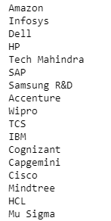
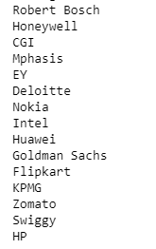
This data is taken from Wikipedia: https://en.wikipedia.org/wiki/Category:Companies_based_in_Bangalore

Slide 8
Data Gathering
Then we can use the FourSquare API to find the number of eateries in a 1km radius around each school. The API will provide us with Postal Code, Neighborhood, Venue, Venue Summary and Venue Category.
Foursquare is a local search-and-discovery service mobile app which provides search results for its users (Wikipedia). It has more than 60 million users.
We can also use the FourSquare API to find all food related categories that we will filter.

Slide 9
Problem Solution
Once we get our entire data in a well defined structure or dataframe, we can cluster the data into various clusters with each office being the reference point and the eateries around it will be the part of clusters.
Also the relative distance of the business from the nearby offices, colleges etc. has to be minimized, while keeping in mind the customers that the place will attract, while maximizing the profits.

Slide 10
Building the Project

Slide 11
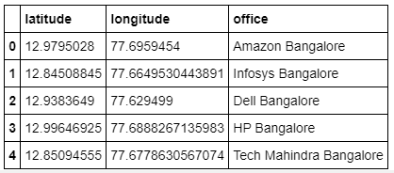
Office locations using the Python Nominatim library

Slide 12
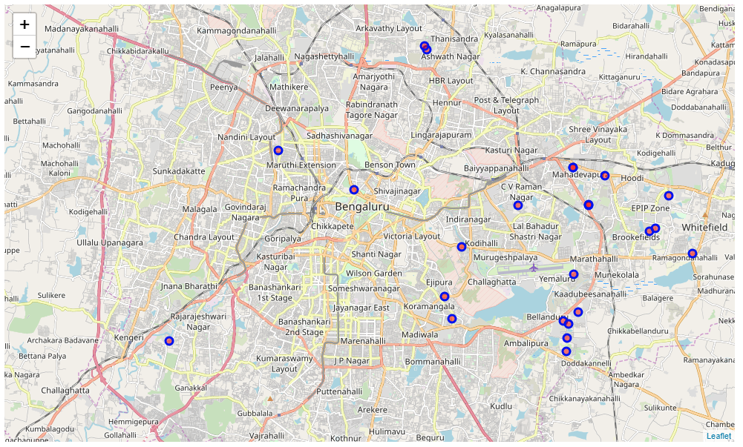
Plotting the offices on a map of Bangalore

Slide 13
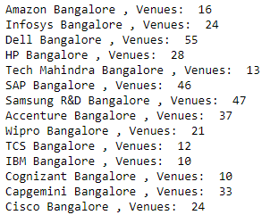
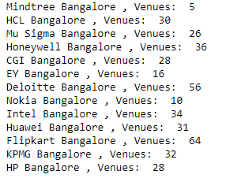
Eateries near these offices

Slide 14
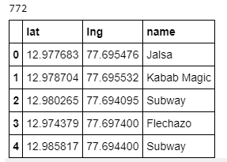
Eateries location using foursquare (772 restaurants)

Slide 15
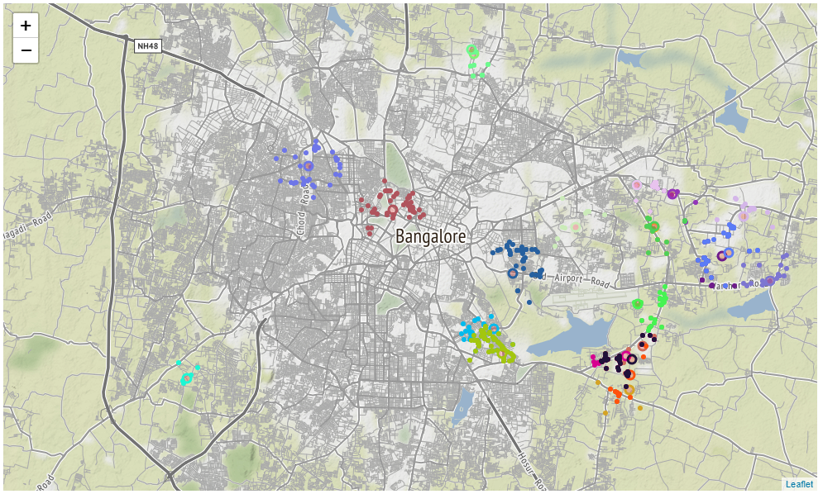
Plotting the eateries (color coded in clusters)

Slide 16
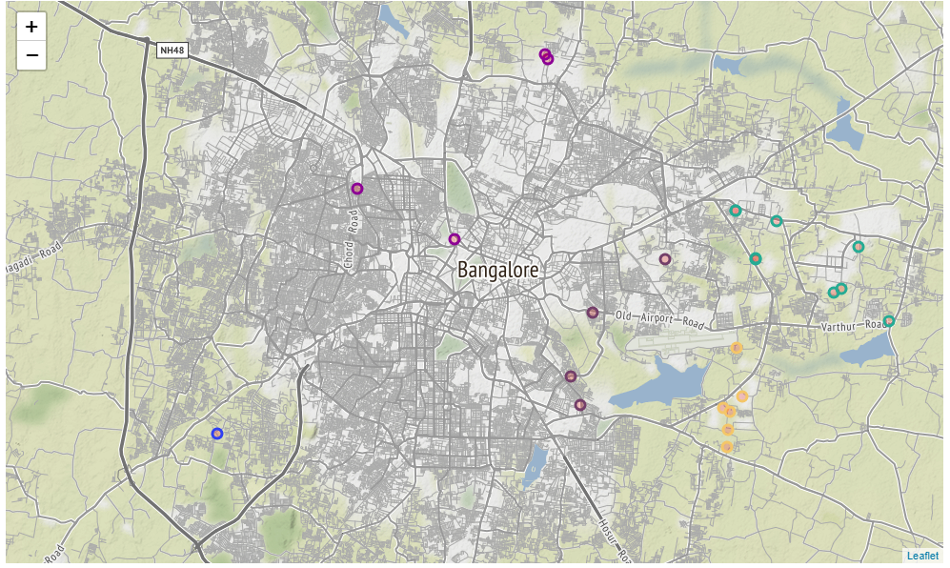
Clustering to group offices distance-wise

Slide 17
Exploration Analysis
From the maps, we can see that some clusters are much smaller than others. Let us look into the counts for each cluster.
Clusters: [(0, 47), (1, 126), (2, 119), (3, 49), (4, 175), (5, 20), (6, 124), (7, 56), (8, 51), (9, 5)]
We can see that cluster 9 has a very small number of eateries around it. But it does not have many offices nearby, so the restaurant will not have many customers.
We can see that clusters 1,2,8 and 9 have a few eateries around them. There are many offices around them and have a large corporate employee population.
A good eatery aimed at corporates, or even at the general public would do well here due to sheer lack of competition in the vicinity; Also because they have a high office:eatery ratio.

Slide 18
Inferences
Hence we find that the best place for a food shop aimed at companies will be either near Deloitte, Intel, EY or Dell in Bangalore due to the best companies:eatery ratio in the cluster.
We also find that 1st, 6th and 4th clusters have approximately 120 eateries near them.
These could be great localities to advertise an upcoming new fast food shop or restaurant.
The first cluster is near Deloitte, Intel, EY or Dell. (Cluster 0 and 3).
The second is near Cognizant, Flipkart, Huawei and Mu Sigma. (Cluster 8 and 7)
Hence these places would be good for setting up and advertising an upcoming new restaurant.

